Slide 1
RoboCup Junior Victoria
Programming Spike Prime
Using MicroPython

Slide 2
Robot programming
What are the programming challenges and how are they best approached?

Slide 3
Rescue Robot Programming
Rule #1 – Construction impacts programming
Rule #2 – Programming impacts construction
Simplicity is the key to successful programming, especially for beginners. If it looks more complicated than necessary, it probably is.

Slide 4
Introduction to the coding interface Opening a new project
From the HOME page
Tutorials
Teaching unit plans
Build instructions
Links to your recent projects
New Project
Open a new coding window
Choose to code in either
WORD BLOCKS (Scratch)
PYTHON
This presentation will focus on coding with Python

Slide 5
Introduction to the “Application Programming Interface” (API)
Quick view of port connections
For details click on the brick icon to open the “Dashboard”
How it looks to you will depend on the ports that you are using
Default code included automatically
Lines 1-3 are Python code libraries that you are likely to use
Line 5 initialises the PrimeHub() class as hub
Line 7 will display a “happy face” on the hub

Slide 6
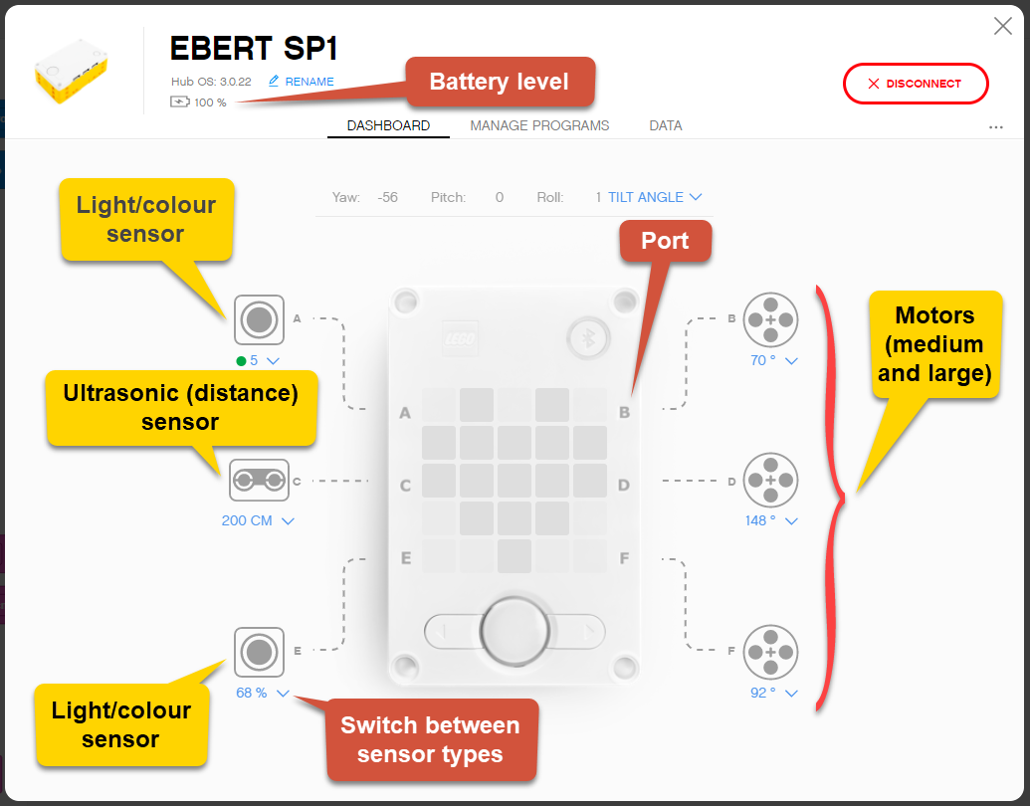
Dashboard
DASHBOARD (if connected)
Battery level indicator
Port position for all connected inputs and outputs
All ports can act as either input or output ports
Readings from each port
What is viewed can be set using the dropdown menu
MANAGE PROGRAMS
Hub can hold up to 20 programs
Options for deleting programs held on hub

Slide 7
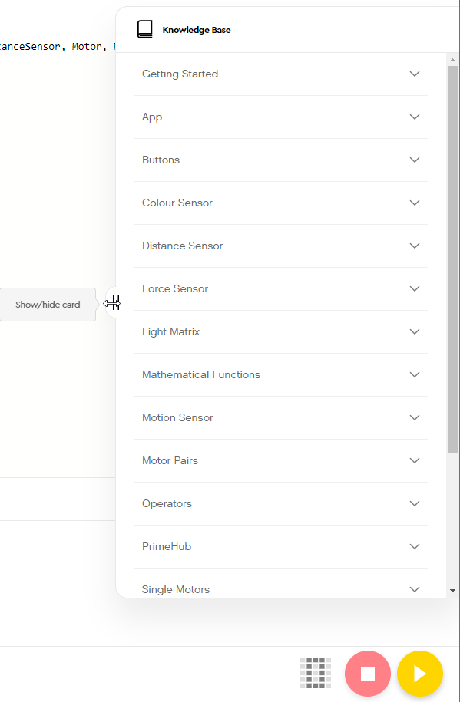
Support – Built in ‘Knowledge Base”
The Knowledge Base
Hidden on the right side of the screen
“Getting Started” contains a limited introduction to programming in Python
Specifically tied to Spike Prime inputs and outputs
Provides examples and challenges
Helps to be familiar with Python
More details are provided in additional dropdowns listed below “Getting Started”

Slide 8
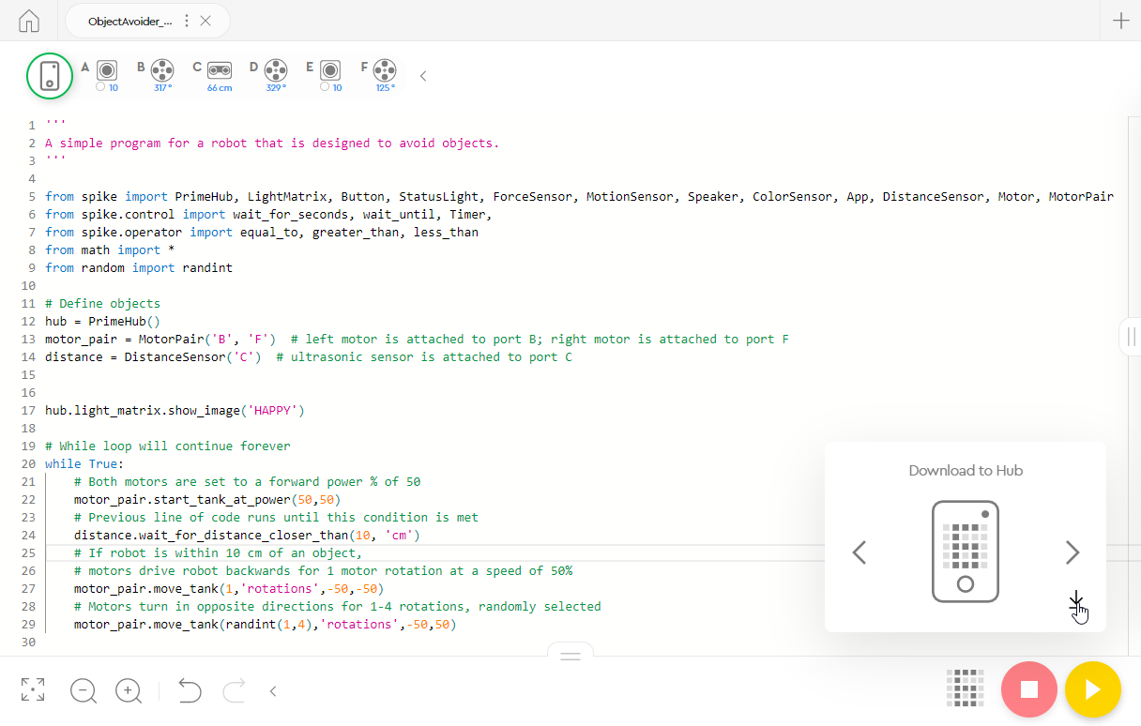
Example of simple program
Things to note:
Encourage students to add comments to explain code (the comments are a bit overdone in this example)
When ready to download code to robot, click on the 5 x 5 grid at the bottom to select the program storage position (0 – 19) on the hub
Click on the down arrow to download to hub

Slide 9
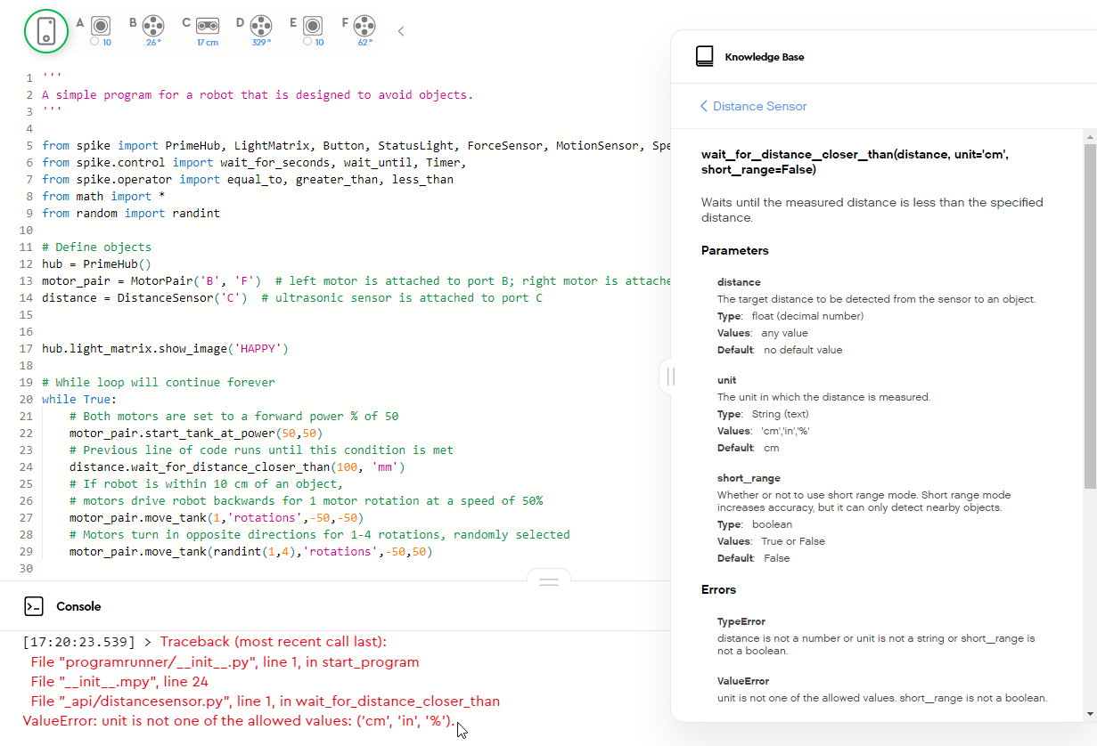
Identifying errors and getting help
If you run the program while connected to the computer, error information will show up in the Console
In this example, the units used in the code are not acceptable
The Knowledge Base will provide details of necessary and acceptable parameters
Note: “Short range” is from 5-30 cm. Default is from 5-200 cm.

Slide 10
Line following
What are the programming challenges and how are they best approached?

Slide 11
Rescue Robot Programming
Where to start?
All Rescue divisions require the robot to:
Follow a line
Locate victim
One light sensor or two?
Riley Rover Rescue (Victoria only) only needs one
All other divisions require two

Slide 12
Principles of Line Following
Case 1
While True: # infinite loop
If sensor sees white:
turn right
If sensor sees NOT white:
turn left
Case 2
While True: # robot on
While sensor sees white:
Turn right
While sensor sees black:
Turn left
What does this look like in code?
Please note: I have not included comments with all example codes. A good exercise for the students is for them to add comments. It forces them to think through the code and also helps them to see the important role that comments play.

Slide 13
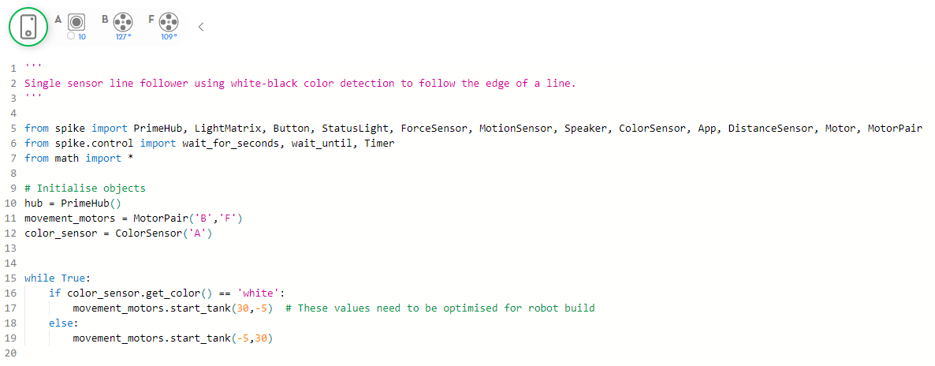
Single Sensor – Case 1
Case 1
While True: # infinite loop
If sensor sees white:
Turn right
Else:
Turn left

Slide 14
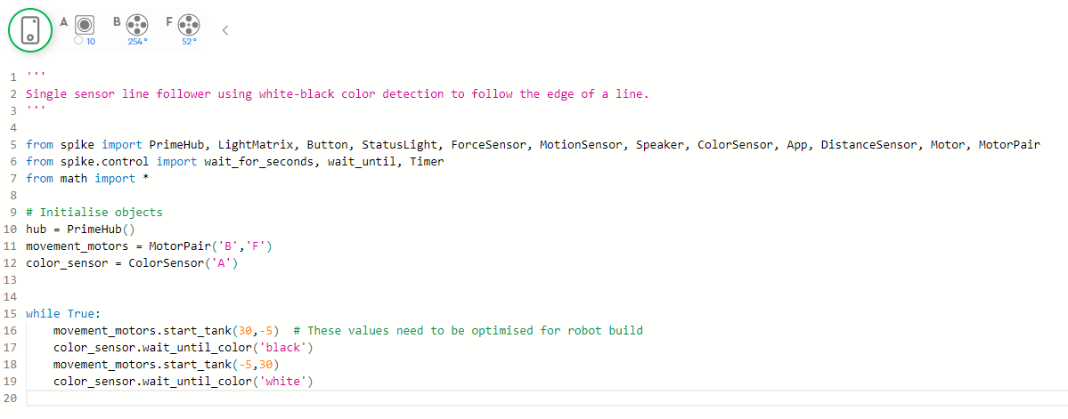
Single Sensor – Case 2
Case 2
While True: # infinite loop
Turn right
Until sensor sees black
Turn left
Until sensor sees white

Slide 15
Single Sensor
I have used colour detection (black-white)
Could this be done using reflected light instead?
How do you decide what to set the reflected light intensity to?
Why would you choose one over the other?
Do motor speed settings matter?
Common pitfalls
Movement motor ports not set
Sensor/motor ports in program don’t correspond to ports used on robot
Motors mounted in reverse orientation
Code needs to be optimised for the robot build and light conditions

Slide 16
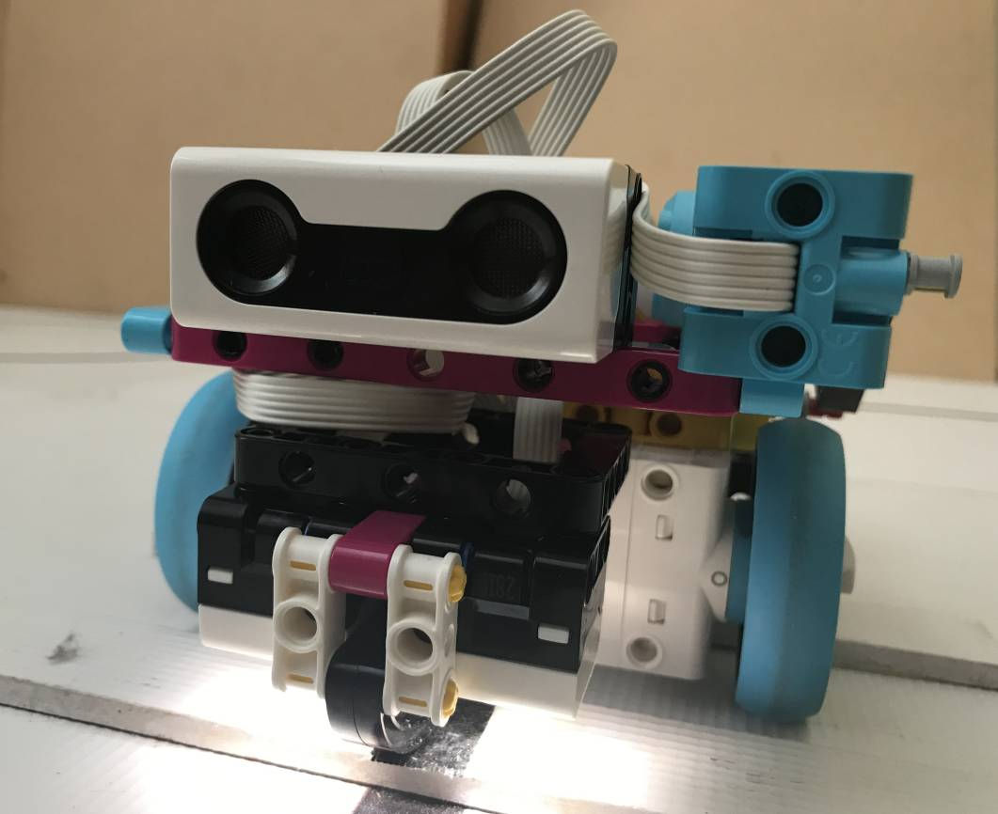
Adding a second sensor
Case 1
While True: # robot on
While sensor_left sees black:
Turn left
While sensor_right sees black:
Turn right
Case 2
While True: #robot on
If sensor_left sees white AND sensor_right sees white:
go straight
If sensor_left sees white AND sensor_right sees black:
turn right
If sensor_left sees black AND sensor_right sees white:
turn left
If sensor_left sees black AND sensor_right sees black:
# Will this ever occur??? What should happen???
What does this look like in code?

Slide 17
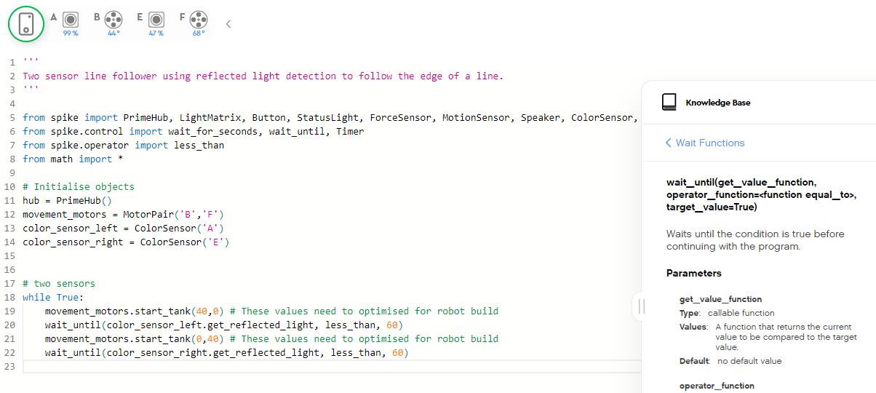
Double sensor – Case 1
Case 1
While True: # infinite loop
Turn right
Until sensor_left sees black
Turn left
Until sensor_right sees black
The “less_than” operator function needs to be imported from the spike library. This is not one of the default imports.
Consider colour vs reflected light, reflected light cut-off values, motor speed settings

Slide 18
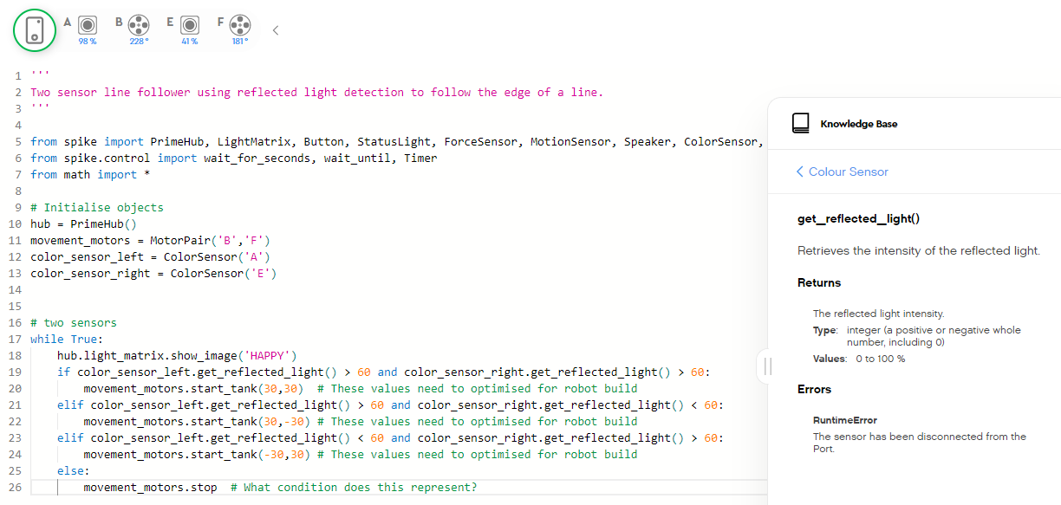
Double sensor – Case 2
What does the “else” condition represent?
Will your robot ever encounter this?
Could this be used to detect green?

Slide 19
Proportional line follower
What if I could adjust the amount the robot turns by how far off the line it is?
Would this make for a much smoother run along the line?
No correction required
Large correction required
While True: #robot on
Input sensor_left value
Input sensor_right value
Turn_value = (sensor_left – sensor_right) × correction_factor
Input turn_value to Move Steering block # if sensor_left > sensor_right, turn_value > 0 and robot turns right
# if sensor_left < sensor_right, turn_value < 0 and robot turns left

Slide 20
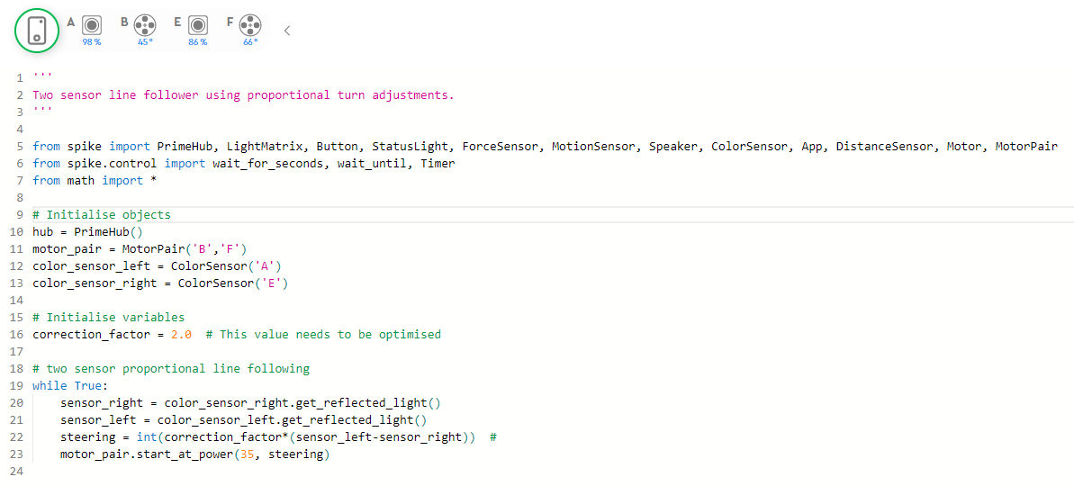
Proportional line follower
2
3
No correction required
3
Small correction required
Larger correction required
No correction
Both sensors on white
98 – 98 = 0
steering = 0
Robot goes straight
Small correction
Right sensor on edge (86)
Left sensor on white (98)
86 – 98 = -12
steering = -12 × 2.0 = -24
Robot turns slight right
Large correction
Right sensor on white (98)
Left sensor on black (28)
98 – 28 = 70
steering = 70 × 2.0 = 140 (NB: max is 100)
Robot turns hard left

Slide 21
Rescuing the victim
What are the programming challenges and how are they best approached?

Slide 22
Rescue
Riley Rover (Victoria only)
Push victim completely out of chemical spill
Primary Rescue
Push victim completely out of chemical spill
Exit chemical spill and recapture line (new in 2021)
Secondary Rescue
Control and release victim in an upright position outside the swamp
Exit chemical spill and recapture line
Open Rescue
Lift victim onto rescue platform in upright position
Exit chemical spill and recapture line

Slide 23
Entering chemical spill and detecting the victim
How can the robot detect chemical spill tile?
Highly reflective tape at entrance
How can the robot detect the victim?
For Riley Rover, it doesn’t need to but more efficient if it does
How can the robot control the victim?
What level of control is needed for each division?
How can the robot exit the spill and regain the line?
Not required for Riley Rover

Slide 24
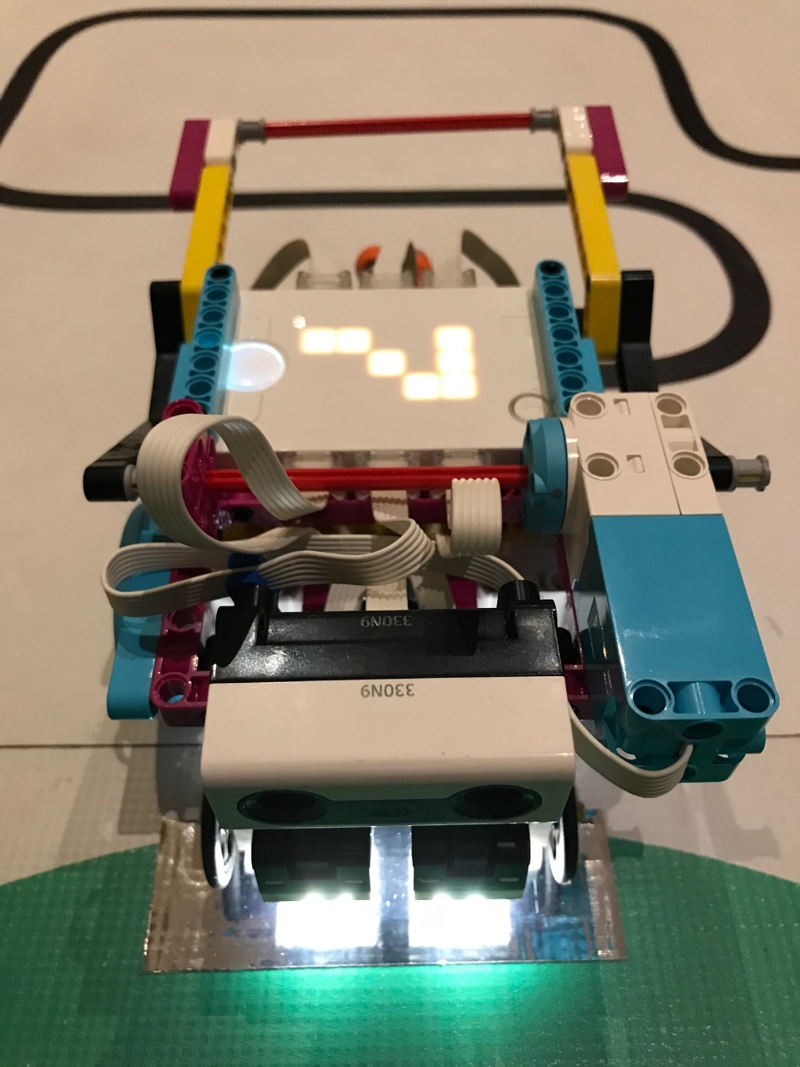
Think through problem – Detecting the spill tile
Detecting chemical spill
Does the reflected value for the foil tape differ from white?
Does the tape have a colour value?
Are measured values for reflected light and colour consistent?
With Spike Prime it is possible to measure the raw red, green and blue values individually. Can this help distinguish the silver foil from white?

Slide 25
Think through problem – Finding the victim
Finding victim
Ultrasonic sensor measures distance from object
Where is the best place to position the robot to begin checking?
What is the maximum distance the victim could be from the robot?
What happens if the sensor is too close to the victim?
Is the ultrasonic sensor able to detect curved surfaces as easily as flat surfaces?
What if alignment is not perfect?
Transmitter
Receiver

Slide 26
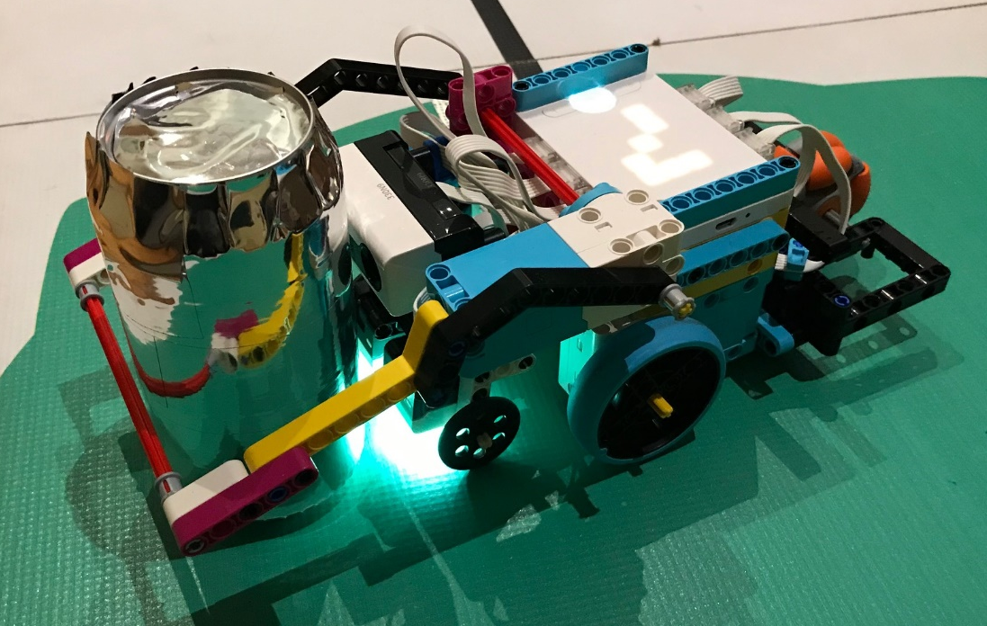
Thinking through problem – Rescuing the victim
Controlling the victim (secondary)
Grabber mechanism
Positive: Can get away with not being perfectly lined up since grabber will gather victim in
Negative: Can be bulky and add to length of robot resulting in course navigation problems
Cage mechanism
Positive: Much more compact
Negative: Need precise alignment
Rescuing the victim
Push/drag rescue capsule to white and release
What happens if the robot has missed or lost control of the rescue capsule?

Slide 27
Think through problem – Finding exit and regaining the line
Finding exit (3 options – are there others?)
Use single light sensor line follower algorithm to follow edge of green until reflective tape is reached
Where would you position the robot relative to the edge?
Random or systematic “walk” until reflective tape is detected
Record and retrace steps

Slide 28
Additional challenges
Detecting intersections
Navigating around water tower

Slide 29
Detecting green at intersections
Robots should turn in the direction of the green marker

Slide 30
Detecting green at intersections
NOTE: The green on Rescue challenge mats used in the Victorian competitions are detected as green by Lego EV3 colour sensors. This is not necessarily the case for all Rescue mats and may not be true if sensors change. There is nothing in the national rules that specifies the shade of green.
Thinking through the problem:
Does the robot turn correctly using a basic line following program? Always? Most of the time? Rarely? Never?
Do the colour sensors detect the “green” as “green”?
Spike Prime colour sensors seem to be more reliable than EV3 sensors
What are the reflected light values when over the green squares? Are they unique individually? As a sum? As a difference? Can you use any of this to reliably detect green?

Slide 31
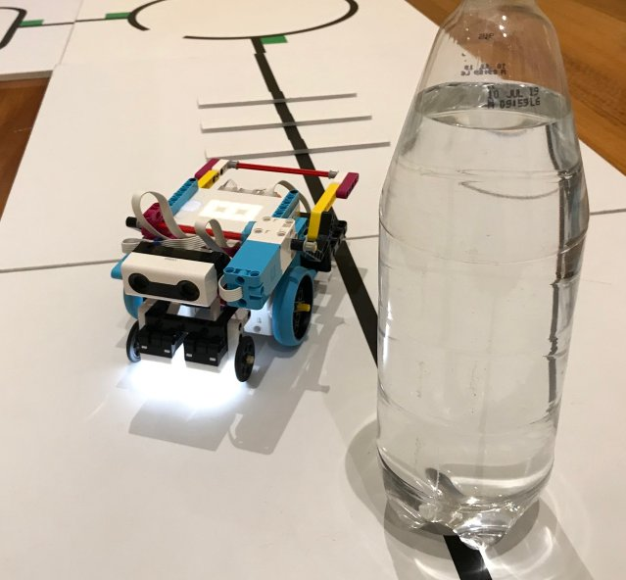
Navigating around water tower
What should be used to detect the water tower (Ultrasonic? Touch?)?
It is relatively easy to pre-program a route around tower, but …
What happens if robot isn’t perfectly aligned with water tower?
How does the robot know when it has found the line again?
Must recapture the line on the same tile to get points

Slide 32
Troubleshooting
Check that:
Port settings in program match ports on robot
Movement motors have been defined correctly
Actual reflected light/colour readings correspond to values set in program
Motor power values are reversed in program if motors are in reverse orientation
All conditional statements are set correctly
Sounds/displays aren’t affecting program flow
And a few tips
Program in small increments
Use the brick displays or sounds to help identify if a particular part of the program is being
Use My Blocks to help organise more complex programs
Save programs with significant changes as a new version, so stable older versions are not lost
On competition days make sure that programs loaded on the brick are functional programs (don’t leave rubbish programs on the brick that could be run by accident)
Make sure that battery is charged

